Slide 1
Additional Stakeholder Input Results
June 1, 2021

Slide 2
Superintendent’s Task Force

Slide 3
Who
Over 100 Participants
Everyone who applied + ...
Certificated Staff
Classified Staff
Principals
Administrators
Students
Community Members
Parents

Slide 4
When/How
When:
2 Virtual Meetings
May 6, 2021
May 20, 2021
How:
Large Group Discussions
Small group breakout sessions
Input captured live
Process:
Meeting 1 - Overarching themes
Meeting 2 - Drilled down to specifics

Slide 5
What We Learned
Communications are important
  Try to appeal to as many people as possible in as many ways as possible
Social media balance
Community Engagement
  Continue opportunities to meet virtually in small groups (i.e. high school feeder)
Concerns about students returning to school in the fall
  Social Emotional Health
  Academic Health
  All staff members must be trained and equipped to support
Strong need to reconnect
Desire to heal divisiveness in the community
Consistency with curriculum, standards and grading
Equity
  Programs, Services and Access
  Safe and Inclusive Learning Environments

Slide 6
ThoughtExchange

Slide 7
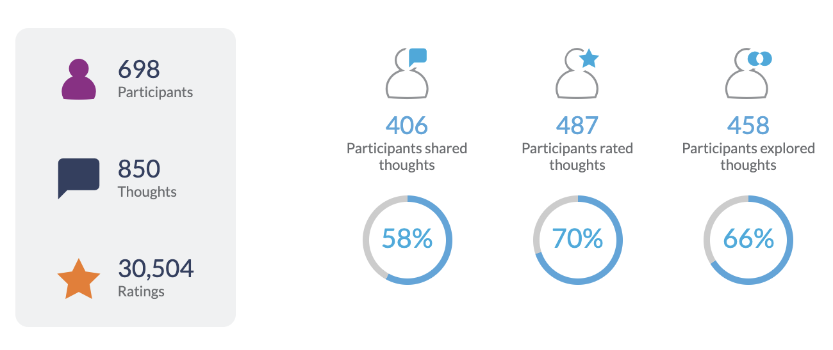
Question: What should the District consider in order to ensure a smooth transition to the 2021-22 school year?
Participation
Main Themes
Smaller Class Sizes
Student Support
Counselors
Paraprofessionals
Interventions
Nurses
Small Groups
Consistency Across the District
Access to Technology
Bell Schedules
Grading
Assessment
Safety
Masks
Cleaning
Follow Guidance

Slide 8
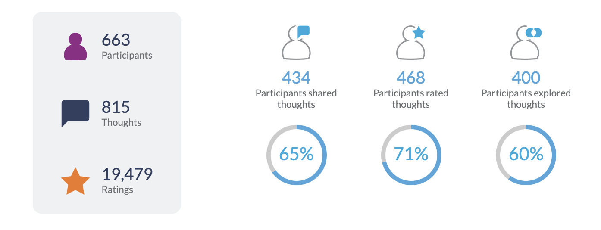
Question: Please provide your input on how you think one-time monies should be prioritized to best support students.
Participation
Main Themes
Smaller Class Sizes
Student Support
Counselors
Psychologists
Nurses
Social Workers
Reading Specialists
Paraeducators
Equitable Access
Technology
Course Offerings
  Art
  Music
Libraries

Slide 9
Common Priorities
Smaller Class Sizes
Student Support
Consistency Across Sites

Slide 10
Final Thoughts

